Slide 1
Central Processing Unit

Slide 2
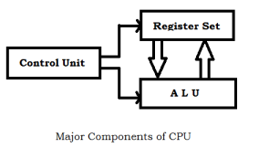
Central Processing Unit
One of the Major functional part in a digital computer is Central Processing Unit.
The main digital hardware functional unit of CPU are control unit, ALU and registers.
The register set stores intermediate data used during the execution of the instruction.
The ALU performs the required micro-operation for executing the instruction.
The control unit supervises the transfer of information among the registers and instruct ALU to perform which operation.

Slide 3
MAJOR COMPONENTS OF CPU
Storage Components:
Registers
Flip-flops
Execution (Processing) Components:
Arithmetic Logic Unit (ALU):
Arithmetic calculations, Logical computations, Shifts/Rotates
Transfer Components:
Bus
Control Components:
Control Unit
Register
File
ALU
Register Organization
1. Single accumulator Organization
2. General register Organization
3. Stack Organization
Control Unit

Slide 4
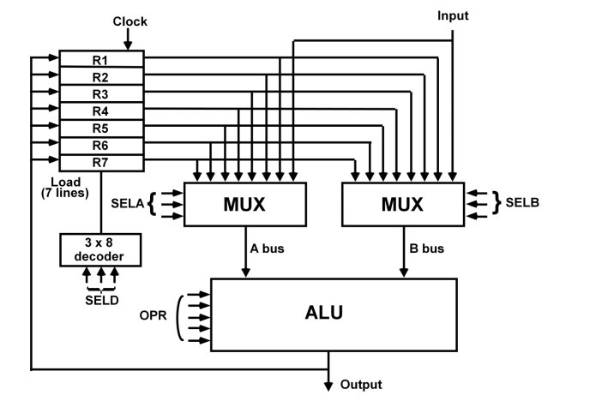
GENERAL REGISTER ORGANIZATION

Slide 5
GENERAL REGISTER ORGANIZATION
Memory locations are needed for storing pointers, counters, return addresses, temporary results, and partial products during multiplication.
As memory access is time consuming process better to have those values in processor registers.
To have a large nos of registers, it have to connected with a common bus system.
It will be part of various micro-operation like arithmetic, logic and shift operation in the processor.
The control unit directs the information flow through ALU by:
- Selecting various Components in the system
- Selecting the Function of ALU

Slide 6

GENERAL REGISTER ORGANIZATION
For example:
R1 <- R2 + R3
MUX A selector (SELA): to place the content of R2 into bus A.
MUX B selector (SELB): to place the content of R3 into bus B.
ALU operation selector (OPR): to provide the arithmetic
addition A + B.
Decoder destination selector (SELD): to transfer the content of the output bus into R1.

Slide 7
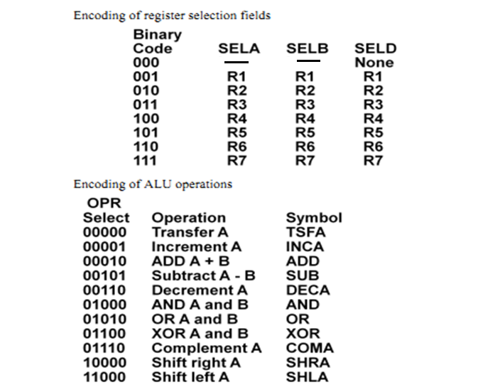
ALU CONTROL

Slide 8
Stack Organization
A stack is a storage device that stores the information in a such manner that the item stored last time is the first item retrieved (LIFO).
The register that holds the address for the stack is called a stack pointer (SP) because its values always points at the top of item in the stack.
There are two types of stack organization
Register Stack – built using registers
Memory Stack – logical part of memory allocated as stack

Slide 9
REGISTER STACK ORGANIZATION
Stack
- Very useful feature for nested subroutines, nested loops control
- Also efficient for arithmetic expression evaluation
- Storage which can be accessed in LIFO
- Pointer: SP
- Only PUSH and POP operations are applicable
stack
Address
Register Stack
Flags
63
FULL
EMPTY
Stack pointer
4
SP
C
3
B
2
A
1
Push, Pop operations
0
DR
/* Initially, SP = 0, EMPTY = 1, FULL = 0 */
PUSH
POP
SP ← SP + 1 DR ← M[SP]
M[SP] ← DR SP ← SP - 1
If (SP = 0) then (FULL ← 1) If (SP = 0) then (EMPTY ← 1)
EMPTY ← 0 FULL ← 0

Slide 10
MEMORY STACK ORGANIZATION
1000
Memory with Program, Data,
and Stack Segments
PC
Program
(instructions)
AR
Data
(operands)
SP
3000
stack
3997
3998
3999
- A portion of memory is used as a stack with a
processor register as a stack pointer
- PUSH: SP ← SP - 1
M[SP] ← DR
- POP: DR ← M[SP]
SP ← SP + 1
- Most computers do not provide hardware to check
stack overflow (full stack) or underflow(empty stack)
4000
4001
DR

Slide 11
Reverse Police notation
--The stack organization is very effective in evaluating arithmetic expressions. Expressions are usually represented in what is known as Infix notation, in which each operator is written between two operands (i.e., A + B).
--Polish notation (prefix notation) – It refers to the notation in which the operator is placed before its two operands . Here no parentheses are required, i.e.,+AB
Reverse Polish notation(postfix notation) – It refers to the analogous notation in which the operator is placed after its two operands. Again, no parentheses is required in Reverse Polish notation, i.e.,AB+
There are 3 levels of precedence for 5 binary operators as given below:
Highest: Exponentiation (^)
Next highest: Multiplication (*) and division (/)
Lowest: Addition (+) and Subtraction (-)

Slide 12
Reverse Police notation
For example –
Infix notation: (A-B)*[C/(D+E)+F]
Post-fix notation: AB- CDE +/F +*
For example –
Infix notation: (2+4) * (4+6)
Post-fix notation: 2 4 + 4 6 + *
Result: 60
The stack operations for this expression evaluation is shown below:

Slide 13
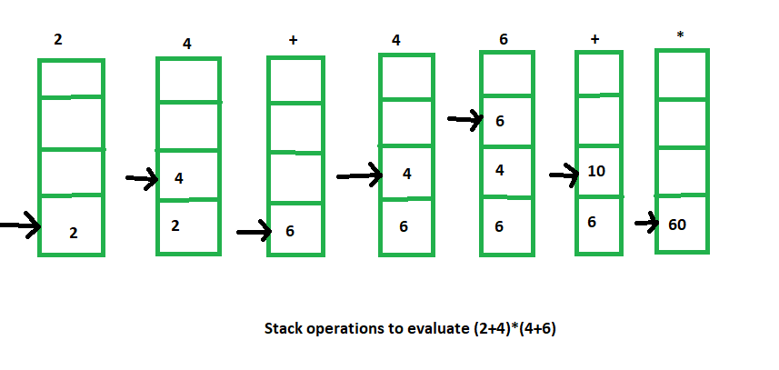
Reverse Police notation
For example –
Post-fix notation: 2 4 + 4 6 + *

Slide 14
Instruction Formats
Instructions are categorized into different formats with respect to operand fields in the instructions.
Three Address Instructions
Two Address Instructions
One Address Instructions
Zero Address Instructions.
Opcode field
Address field
mode

Slide 15
Instruction Formats (Cont.)
Three Address Instructions :
Computers with three address instruction formats can use each address field to specify either a processor register or memory operand
The program in assembly language that evaluates X= (A+B) * (C+D) is shown below:
ADD R1 , A, B R1 ← M[A] + M[B]
ADD R2 , C, D R2 ← M[C] + M[D]
MUL X, R1, R2 M[X] ← R1 * R2
The advantage of three address format is that it results in short programs when evaluating arithmetic expressions.
The disadvantage is that binary-coded instructions require too many bits to specify three address.

Slide 16
Instruction Formats (Cont.)
Two Address Instructions :
Two address instruction are most common in commercial computers. Here again each address field can specify either processor register or a memory word.
The program in assembly language that evaluates X= (A+B) * (C+D) is shown below:
ADD R1 , A R1 ← M[A]
ADD R1 , B R1 ← M[B]
ADD R2 , C R2 ← M[C]
ADD R2 , D R2 ← M[D]
MUL R1, R2 R1 ← R1 * R2
MOV X,R1 M[X] ← R1

Slide 17
Instruction Formats (Cont.)
One Address Instructions :
One address instruction use an implied accumulator register for all data manipulation.
For multiplication and division, there is need for a second register.
However, here we will neglect a second register and assume that the AC contains the result of all operations.
The program to evaluate X= (A+B) * (C+D) is
LOAD A AC ← M[A]
ADD B AC ← AC+M[B]
STORE T M[T] ← AC
LOAD C AC ← M[C]
ADD D AC ← AC+M[D]
MUL T AC ← AC * M[T]

Slide 18
Instruction Formats (Cont.)
Zero Address Instructions :
A stack organized computer does not use an address field for the instructions ADD and MUL.
The PUSH and POP instructions, however need an address field to specify the operand that communicates with the stack.
The program to evaluate X= (A+B) * (C+D) will be written for a stack organized computer.
To evaluate arithmetic expression into reverse police notation.
PUSH A TOS ← M[A]
PUSH B TOS ← M[A]
ADD TOS ← (A+B)
PUSH C TOS ← M[C]
PUSH D TOS ← M[D]
ADD TOS ← (C+D)
MUL TOS ← (A+B) * (C+D)

Slide 19
ADDRESSING MODES
Addressing Modes:
*The various formats for specifying the operands is called Addressing Mode
*Specifies a rule for interpreting or modifying the
address field of the instruction (before the operand
is actually referenced)
The purpose of using addressing modes is as follows:
To give the programming versatility to the user.
To reduce the number of bits in addressing field of instruction.

Slide 20
TYPES OF ADDRESSING MODES
Implied Mode
Address of the operands are specified implicitly
in the definition of the instruction
- No need to specify address in the instruction
- EA = AC, or EA = Stack[SP], EA: Effective Address.
For eg. CMA –complement accumulator
Immediate Mode
Instead of specifying the address of the operand,
operand itself is specified For eg. MOV R1,05H. (data not address)
- No need to specify address in the instruction
- However, operand itself needs to be specified
- Sometimes, require more bits than the address
- Fast to acquire an operand
Register Mode
Address specified in the instruction is the register address
- Designated operand need to be in a register
- Shorter address than the memory address
- Saving address field in the instruction
- Faster to acquire an operand than the memory addressing
- EA = IR(R) (IR(R): Register field of IR) For eg. MOV AX,BX

Slide 21
TYPES OF ADDRESSING MODES
Register Indirect Mode
Instruction specifies a register which contains the memory address of the operand
- Saving instruction bits since register address
is shorter than the memory address
- Slower to acquire an operand than both the
register addressing or memory addressing
- EA = [IR(R)] ([x]: Content of x)
For eg. MOV [R1],R2 -- value of R2 is moved to memory location specified in R1
Auto-increment or Auto-decrement features:
Same as the Register Indirect, but:
- When the address in the register is used to access memory, the value in the register is incremented or decremented by 1 (after or before the execution of the instruction)
It means --- Increment after execution
----decrement before execution

Slide 22
TYPES OF ADDRESSING MODES
Direct Address Mode
* Effective address is equal to the address part of instruction.
*Instruction specifies the memory address which can be used directly to the physical memory
- Faster than the other memory addressing modes
- Too many bits are needed to specify the address
for a large physical memory space
- EA = IR(address), (IR(address): address field of IR). For eg. ADD 457. –data is resides in this specified address.
Indirect Addressing Mode
The address field of an instruction specifies the address of a memory location that contains the address of the operand
- When the abbreviated address is used, large physical memory can be addressed with a relatively small number of bits
- Slow to acquire an operand because of an additional memory access
- EA = M[IR(address)]

Slide 23
Relative Addressing Modes
In this mode, The content of Program Counter (PC) is added to the address part of the instruction in order to obtain the effective address.
Relative Addressing Mode(R = PC)
- EA = PC + IR(address)
- Address field of the instruction is short
- Large physical memory can be accessed with a small number of address bits
Indexed Addressing Mode
In this mode, the content of index register is added to the address part of the instruction to obtain the effective address.
XR: Index Register:
- EA = XR + IR(address)
--used in accessing array from memory.
Base Register Addressing Mode
In this mode, content of base register is added to the address part of instruction to obtain effective address.
BAR: Base Address Register:
- EA = BAR + IR(address)
--used in program relocation
--used when we are having certain displacement, provide displacement to base register.

Slide 24
ADDRESSING MODES - EXAMPLES
Address
Memory
200
Load to AC Mode
PC = 200
201
Address = 500
202
Next instruction
R1 = 400
XR = 100
399
450
400
700
AC
500
800
600
900
Addressing
Mode
Effective
Address
Content
of AC
Direct address
Immediate operand
Indirect address
Relative address
Indexed address
Register
Register indirect
Autoincrement
Autodecrement
702
325
800
300

Slide 25
ADDRESSING MODES - EXAMPLES
Address
Memory
200
Load to AC Mode
PC = 200
201
Address = 500
202
Next instruction
R1 = 400
XR = 100
399
450
400
700
AC
500
800
600
900
Addressing
Mode
Effective
Address
Content
of AC
Direct address 500 /* AC ← (500) */ 800
Immediate operand - /* AC ← 500 */ 500
Indirect address 800 /* AC ← ((500)) */ 300
Relative address 702 /* AC ← (PC+500) */ 325
Indexed address 600 /* AC ← (XR+500) */ 900
Register - /* AC ← R1 */ 400
Register indirect 400 /* AC ← (R1) */ 700
Autoincrement 400 /* AC ← (R1)+ */ 700
Autodecrement 399 /* AC ← -(R) */ 450
702
325
800
300

Slide 26
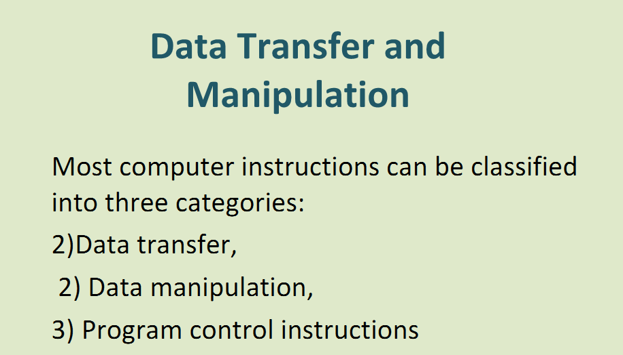

Slide 27
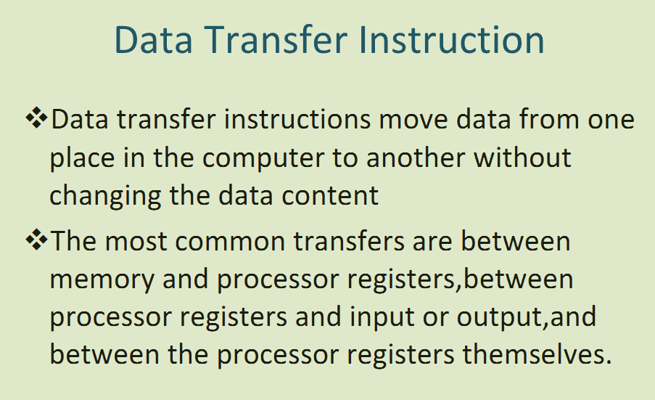

Slide 28
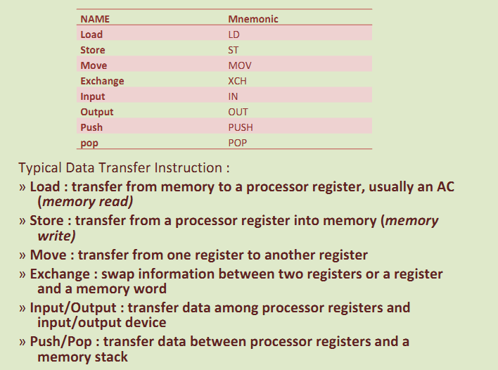

Slide 29
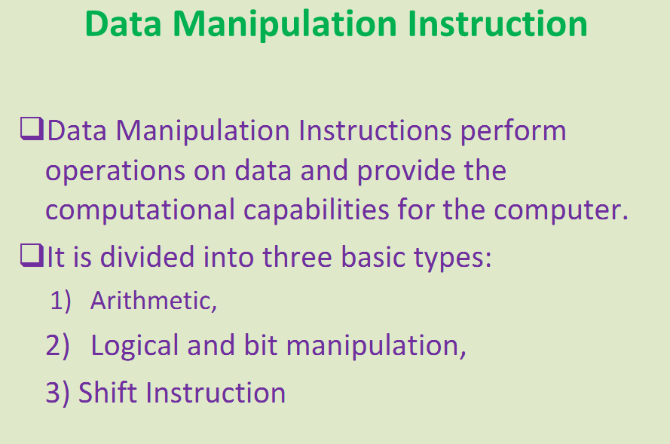

Slide 30
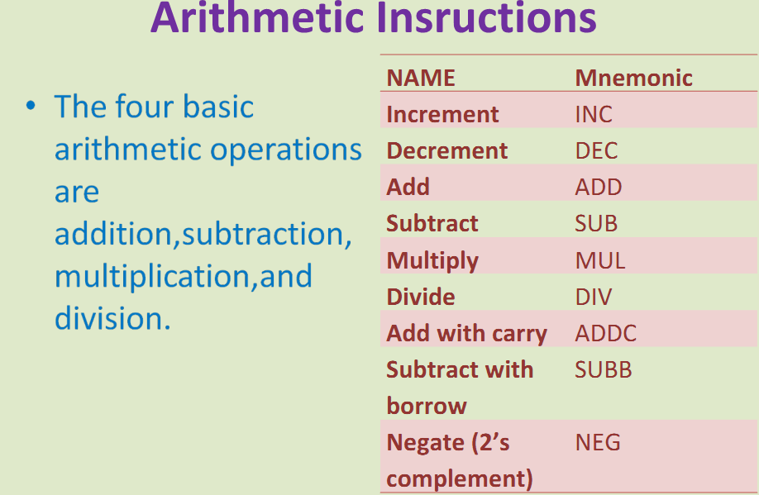

Slide 31
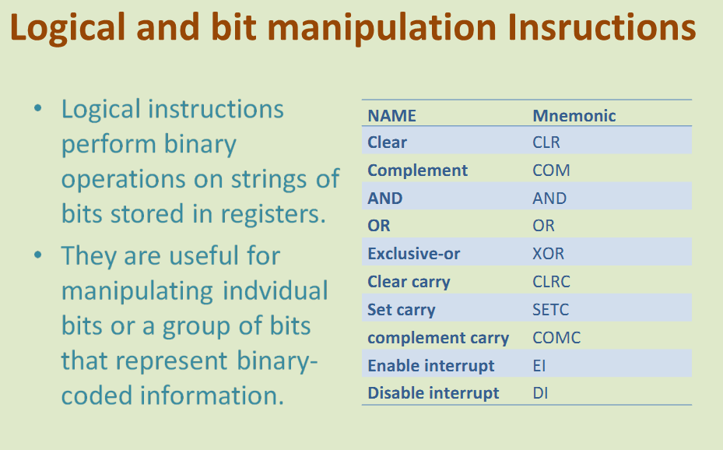

Slide 32
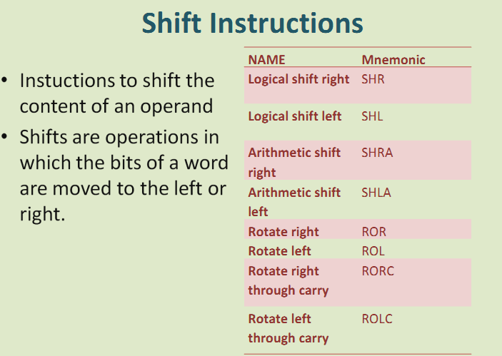

Slide 33
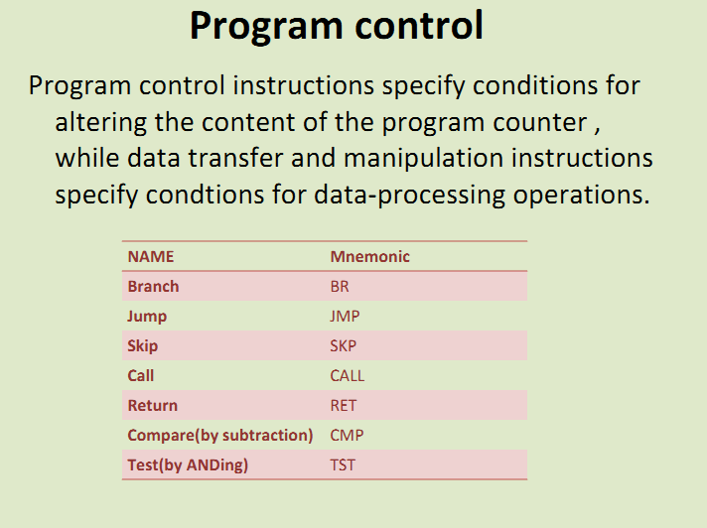

Slide 34
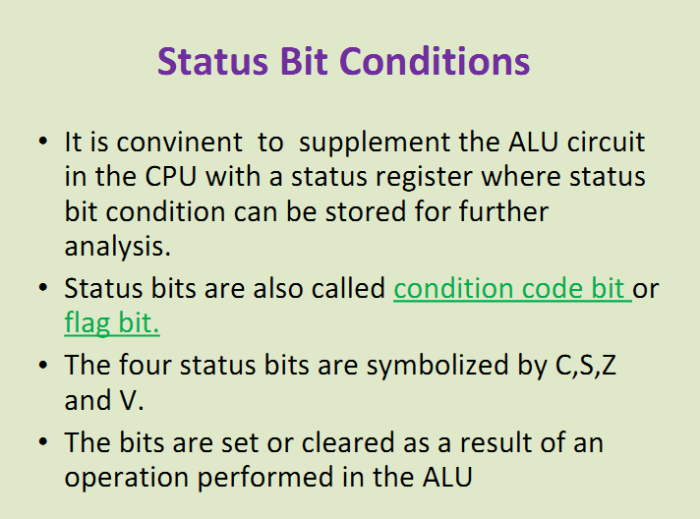

Slide 35
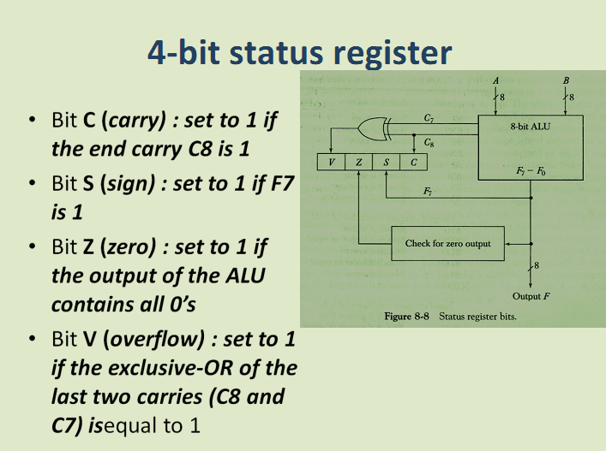

Slide 36
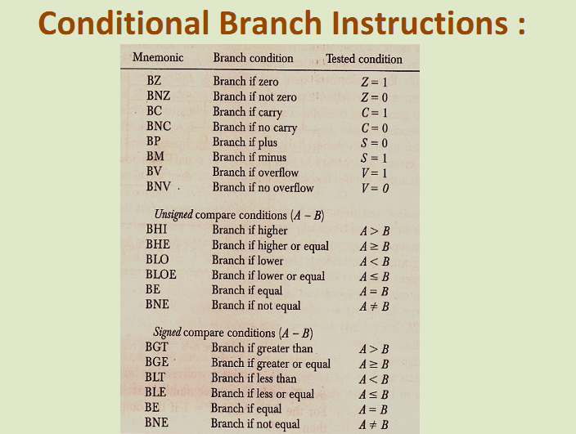

Slide 37
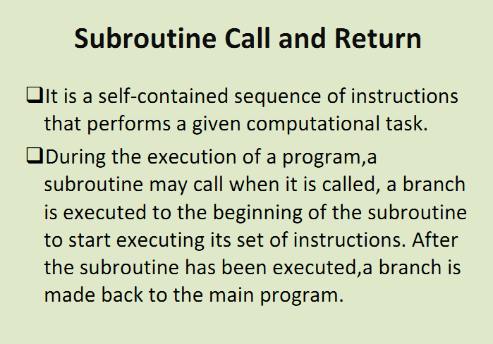

Slide 38
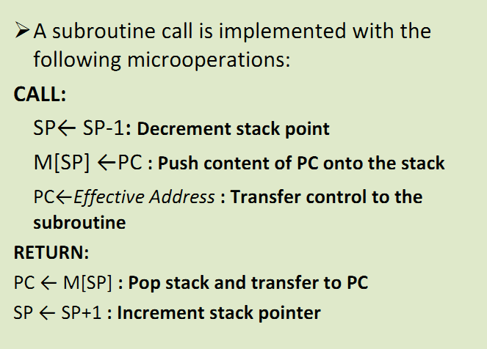

Slide 39
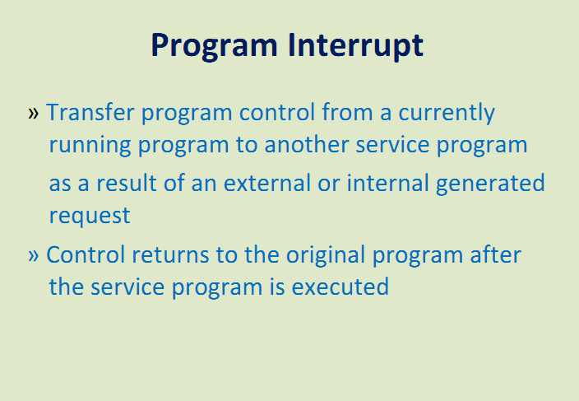

Slide 40
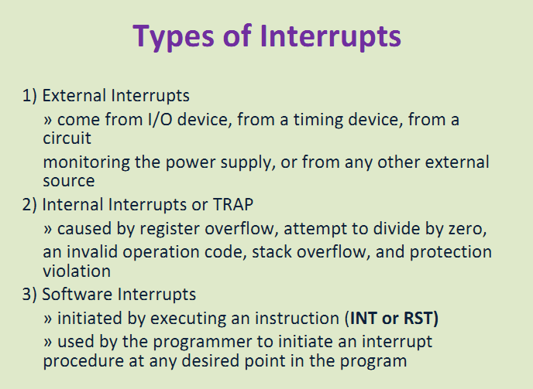

Slide 41
RISC: REDUCED INSTRUCTION SET COMPUTERS
Historical Background
IBM System/360, 1964
- The real beginning of modern computer architecture
- Distinction between Architecture and Implementation
- Architecture: The abstract structure of a computer
seen by an assembly-language programmer
Compiler
μ-program
High-Level
Language
Instruction
Set
Hardware
Architecture
Implementation
Continuing growth in semiconductor memory and microprogramming
-> A much richer and complicated instruction sets
=> CISC(Complex Instruction Set Computer)
- Arguments advanced at that time
Richer instruction sets would simplify compilers
Richer instruction sets would alleviate the software crisis
- move as much functions to the hardware as possible
- close Semantic Gap between machine language
and the high-level language
Richer instruction sets would improve the architecture quality

Slide 42
COMPLEX INSTRUCTION SET COMPUTERS: CISC
High Performance General Purpose Instructions
Characteristics of CISC:
A large number of instructions (from 100-250 usually)
Some instructions that performs a certain tasks are not used frequently.
Many addressing modes are used (5 to 20)
Variable length instruction format.
Instructions that manipulate operands in memory.

Slide 43
PHYLOSOPHY OF RISC
Reduce the semantic gap between
machine instruction and microinstruction
1-Cycle instruction
Most of the instructions complete their execution
in 1 CPU clock cycle - like a microoperation
* Functions of the instruction (contrast to CISC)
- Very simple functions
- Very simple instruction format
- Similar to microinstructions
=> No need for microprogrammed control
* Register-Register Instructions
- Avoid memory reference instructions except
Load and Store instructions
- Most of the operands can be found in the
registers instead of main memory
=> Shorter instructions
=> Uniform instruction cycle
=> Requirement of large number of registers
* Employ instruction pipeline

Slide 44
CHARACTERISTICS OF RISC
Common RISC Characteristics
- Operations are register-to-register, with only LOAD and STORE accessing memory
- The operations and addressing modes are reduced
Instruction formats are simple

Slide 45
CHARACTERISTICS OF RISC
RISC Characteristics
- Relatively few instructions
- Relatively few addressing modes
- Memory access limited to load and store instructions
- All operations done within the registers of the CPU
- Fixed-length, easily decoded instruction format
- Single-cycle instruction format
- Hardwired rather than microprogrammed control
More RISC Characteristics
A relatively large numbers of registers in the processor unit.
Efficient instruction pipeline
Compiler support: provides efficient translation of high-level language
programs into machine language programs.
Advantages of RISC
- VLSI Realization
- Computing Speed
- Design Costs and Reliability
- High Level Language Support

Slide 46
